Slide 1
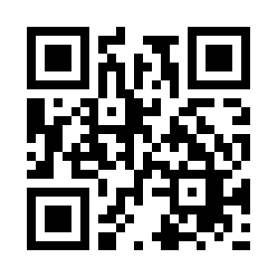

Software Project Planning Quiz
https://bit.ly/3fW6WsX

